Slide 1
Status of DAWN Data from NASA GRIP Campaign
Michael Kavaya
NASA Langley Research Center
michael.j.kavaya@nasa.gov
GRIP Science Team Meeting
May 9-10, 2012

Slide 2
Acknowledgements
NASA SMD
Jack Kaye, Ramesh Kakar
NASA SMD ESTO
George Komar, Janice Buckner, Parminder Ghuman, Carl Wagenfuehrer
NASA LaRC Director Office, Steve Jurczyk
NASA LaRC Engineering Directorate, Jill Marlowe, John Costulis
NASA LaRC Chief Engineer Office, Clayton Turner
NASA LaRC Science Directorate
Garnett Hutchinson, Stacey Lee, Keith Murray
Simpson Weather Associates
Dave Emmitt
Many colleagues at LaRC including discipline leads:
Jeffrey Beyon, Garfield Creary, Grady Koch, Paul Petzar, Upendra Singh, Bo Trieu, Jirong Yu

Slide 3
GRIP DC-8 and DAWN Wind Lidar: By the Numbers
 | All Flights | Science Flights
Dates | 8/5 - 9/25/10 | 8/17 - 9/22/10
Flights | 25 | 15
DAWN Scan Patterns* | 13,062 | 11,685
DAWN Laser Shots | 2,243,620 | 2,058,520
DAWN Emitted Photons** | 5.8 10²⁴ | 5.3 10²⁴
 | Total | Fraction
DC-8 Flight Minutes | 6712 | 5987 (89%) DAWN Collecting Data
DAWN Data Minutes | 5987 | 4634 (95%) Uploaded to GRIP Web Site
*scan pattern yields horizontal wind vertical profile; ~1 dropsonde
**assuming 250 mJ pulses

Slide 4
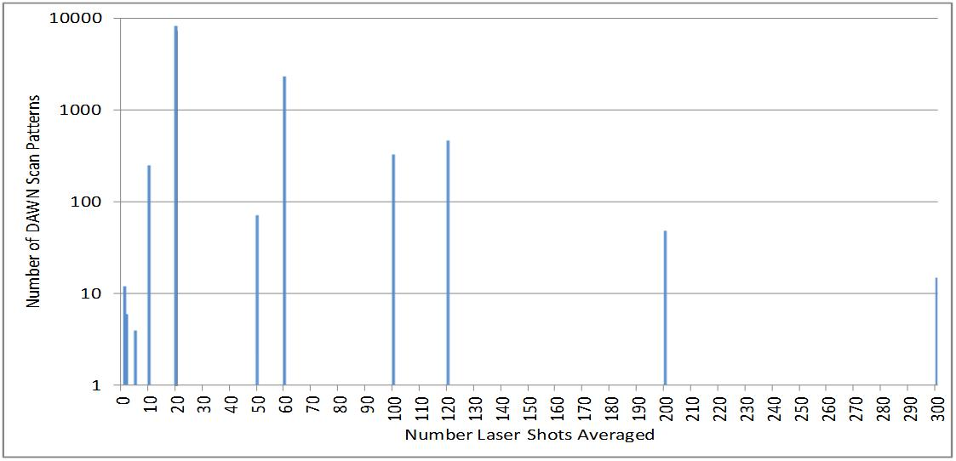
Lidar Scan Patterns vs. Number Laser Shots Averaged
Measurement Time & Horizontal Range Resolution
Shots Averaged | Scan Pattern Time | If V_{DC8} = 450 knots = 231.5 m/s
20 | 22 s | 5.1 km
60 | 42 s | 9.7 km
120 | 72 s | 16.7 km

Slide 5
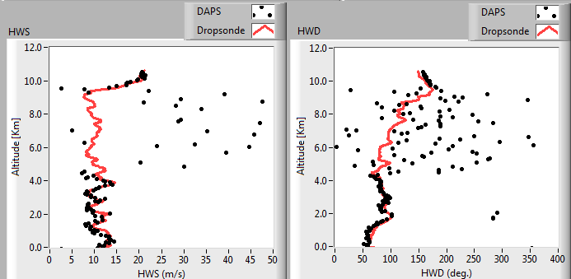
Example: Comparison DAWN to Dropsonde
9/1/10, data folder 161736, 20 shots averaged, 5.1 km resolution, Earl
12 km
N = number shots averaged
Agreement near the DC-8 and 0 – 4 km altitude

Slide 6
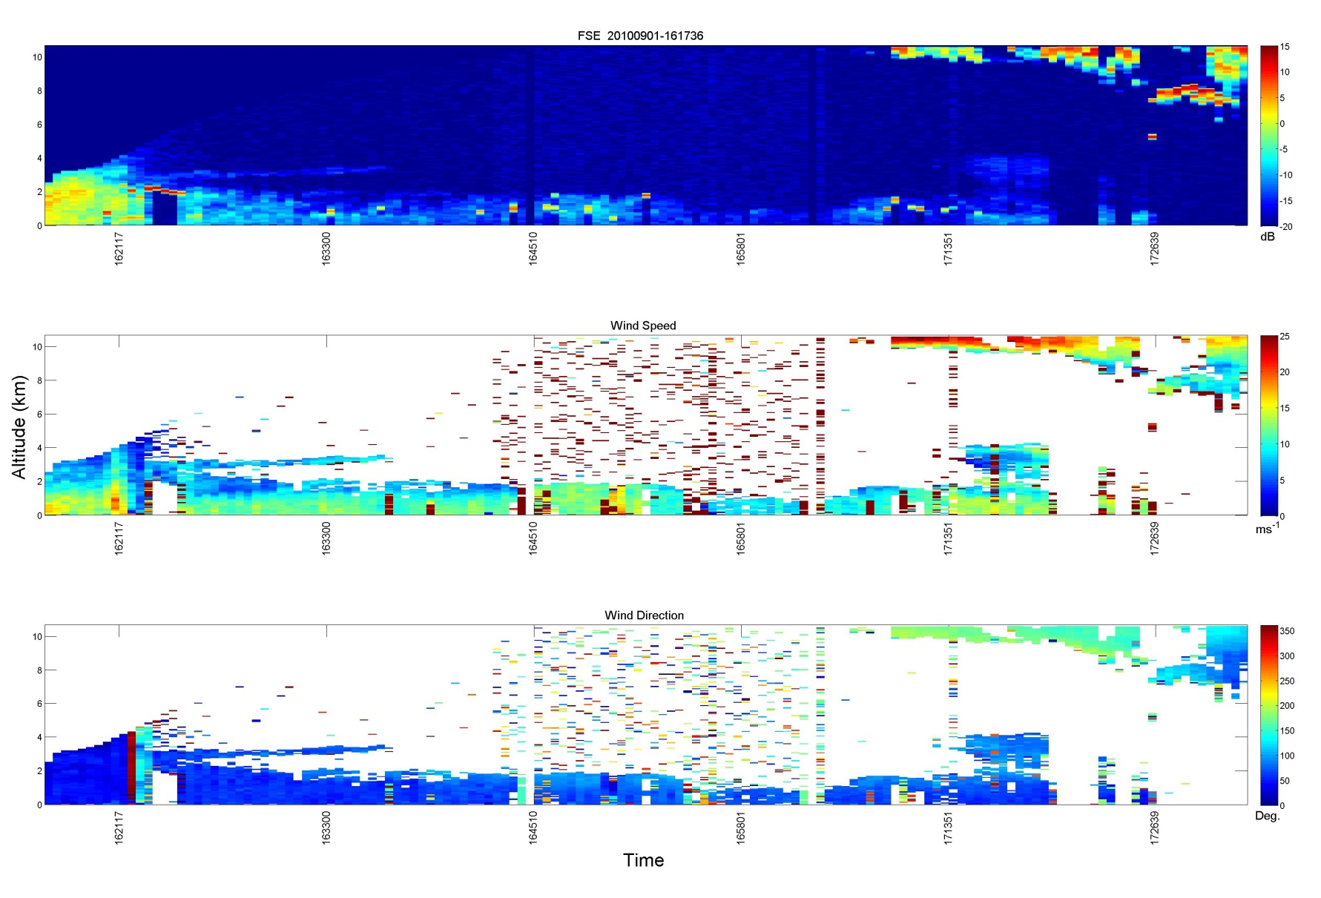
Example: Vertical Slice, ~ 75 Minutes Duration, 20 Shots Averaged,
~5.1 km Resolution, Taking off from Ft. Lauderdale, Earl
9/1/10, data folder 161736
10 km
Energy
10 km
25 m/s
Speed
10 km
Direction
Region of relatively high aerosol backscatter
This is the uploaded data type
FSE = Frequency-domain signal energy estimate
~ 17:20:15 dropsonde launch time of previous slide

Slide 7
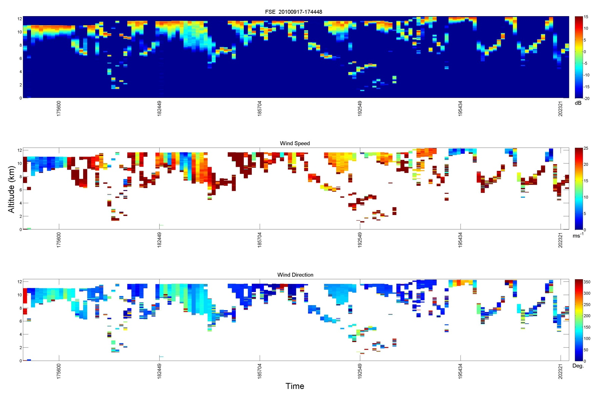
Example: Vertical Slice, ~ 163 Minutes Duration, 100 Shots Averaged,
~14.4 km Resolution, Karl, No Visible Eye
9/17/10, data folder 174448
12 km
Energy
12 km
25 m/s
Speed
12 km
Direction
Ends ~ 20:24:00
Note: ascending and descending clouds; lots of repeated flight legs

Slide 8
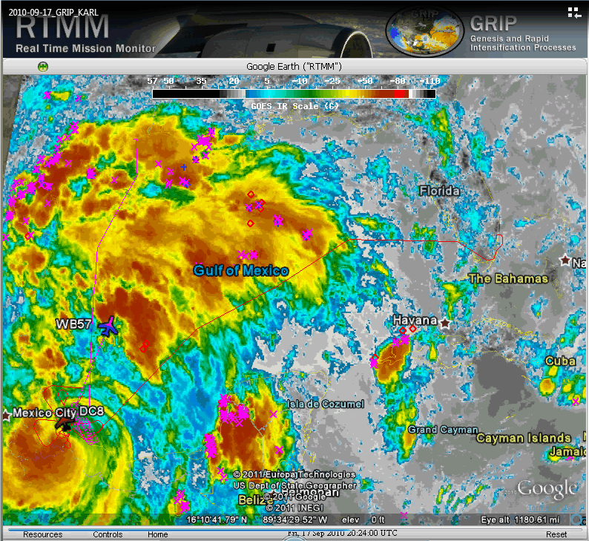
Example: Vertical Slice, ~ 163 Minutes Duration, 100 Shots Averaged,
~14.4 km Resolution, Karl, No Visible Eye
9/17/10, data folder 174448
End of previous slide data, repeated flight legs shown

Slide 9
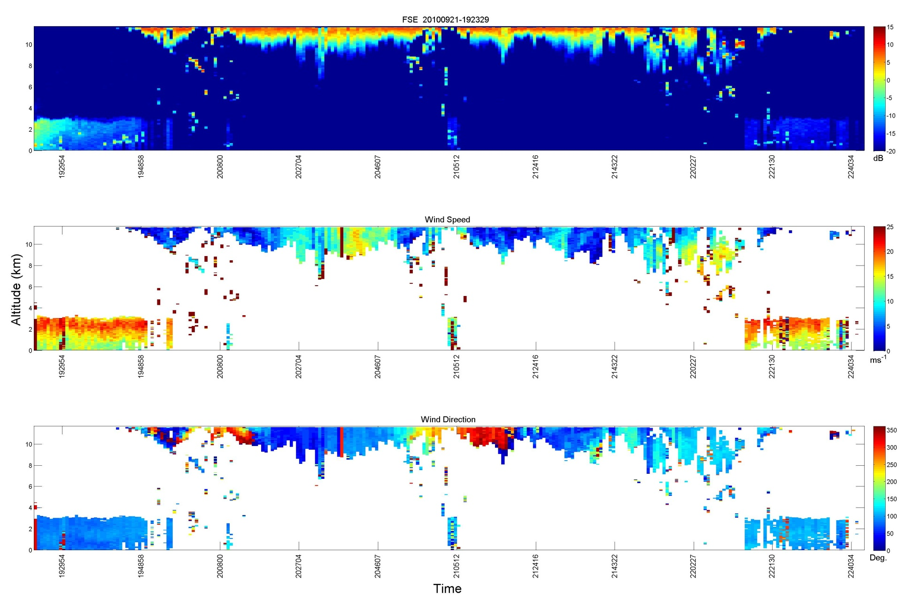
Example: Vertical Slice, ~ 202 Minutes Duration,
60 Shots Averaged, ~9.7 km Resolution, PG146, AL95, No Visible Eye
9/21/10, data folder 192329
10 km
Energy
10 km
25 m/s
Speed
complete circle
10 km
Direction
Note: complete direction sweep centered ~ 21:00:00; wind measurement extends below obvious FSE; BL to cloud deck transitions

Slide 10
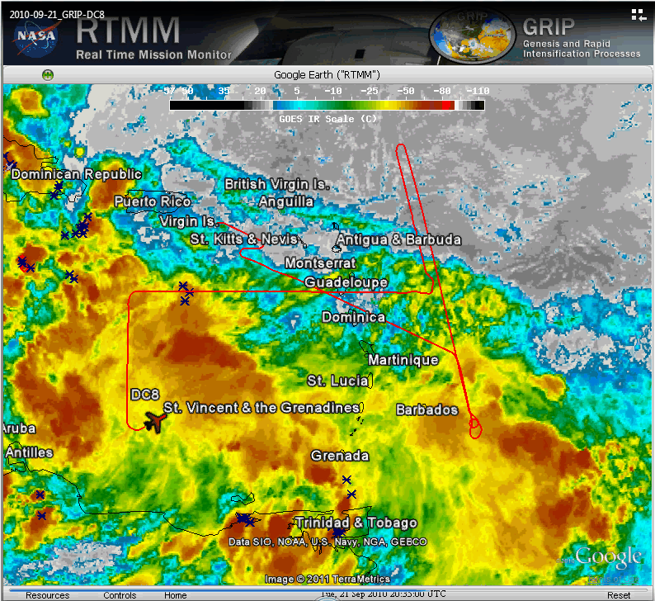
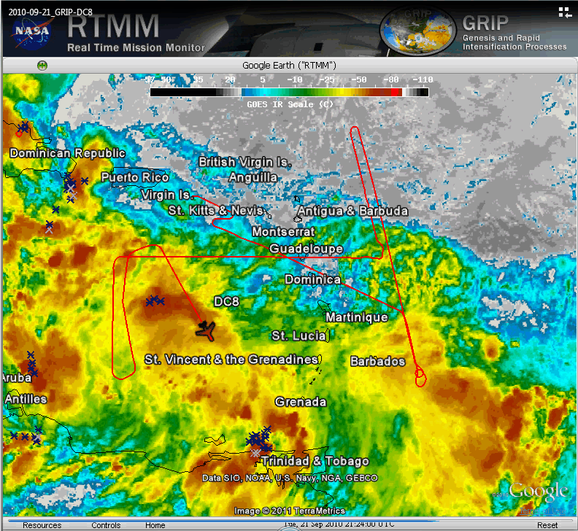
Example: Vertical Slice, ~ 202 Minutes Duration,
60 Shots Averaged, ~9.7 km Resolution, PG146, AL95, No Visible Eye
9/21/10, data folder 192329
Complete Circle of Wind Direction
20:35:00, ~Begin
21:24:00, ~End

Slide 11

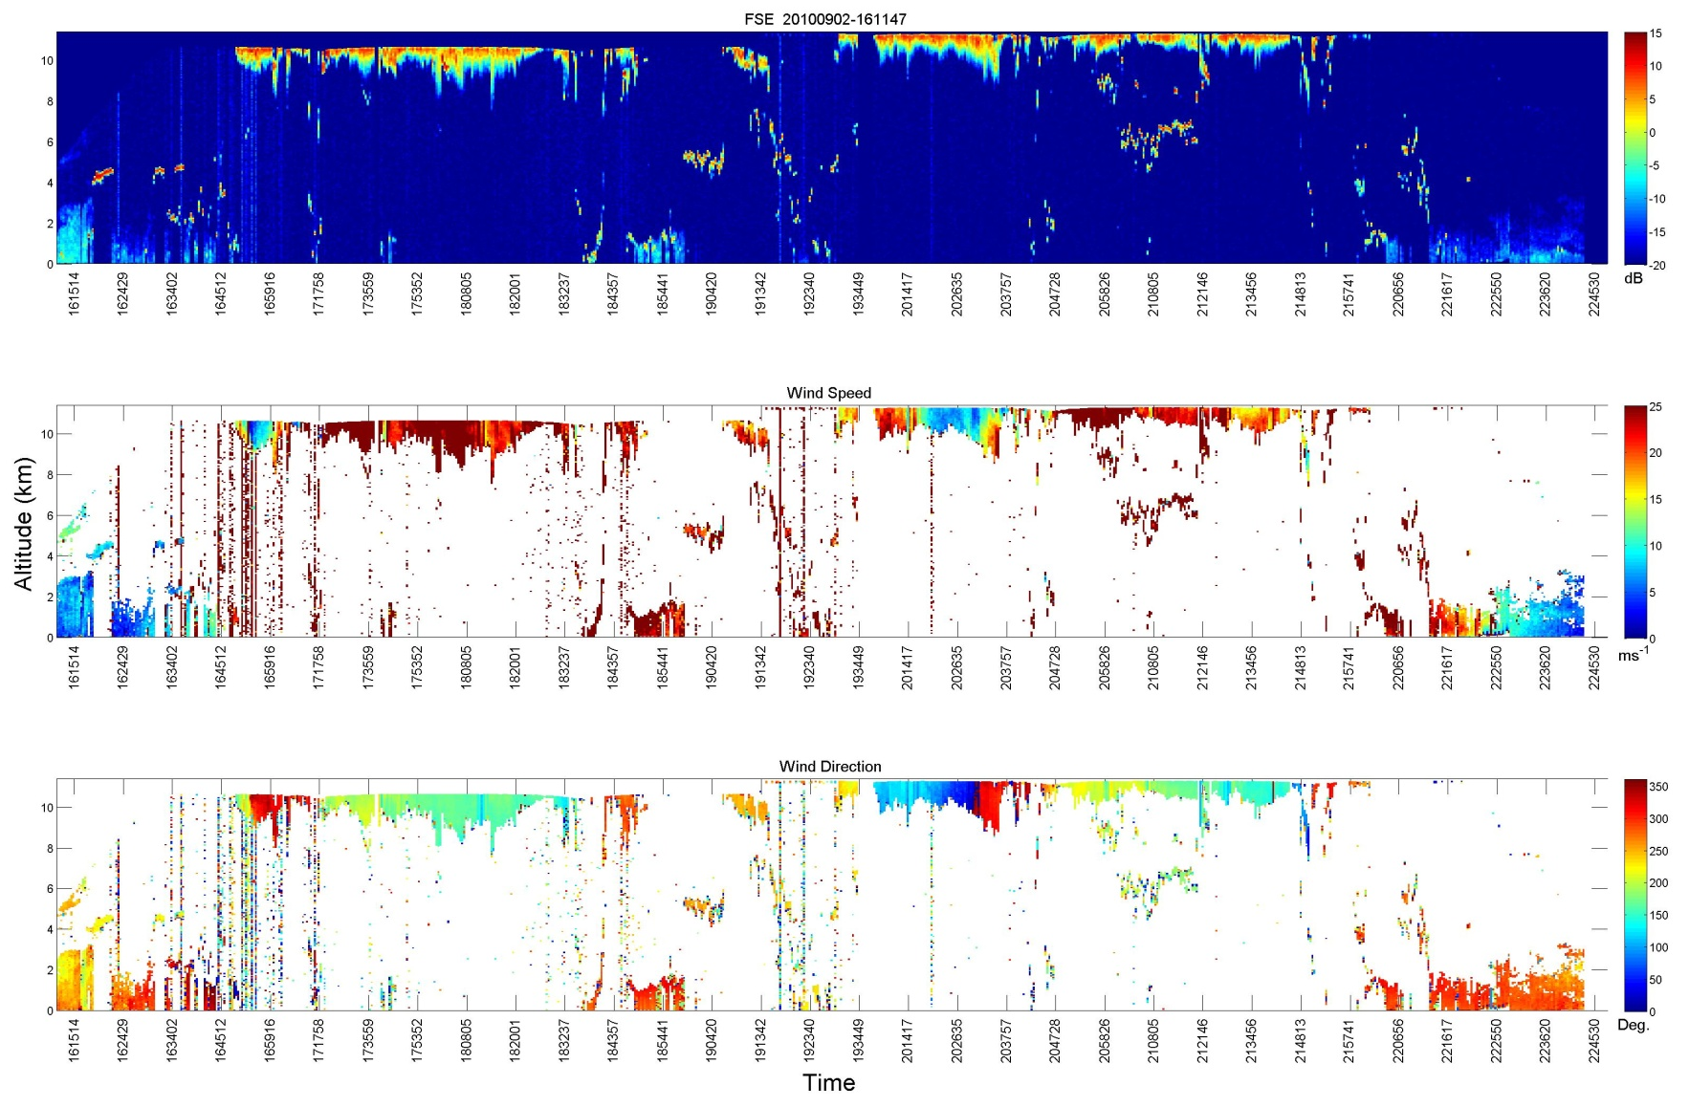
Example: Vertical Slice, ~ 396 Minutes Duration,
20 Shots Averaged, ~5.1 km Resolution, Earl, Visible Eye
9/2/10, data folder 161147
10 km
Energy
10 km
25 m/s
Speed
10 km
Direction
Note: eye clearly seen in lidar data; MBL & cloud layers at 5 km; 791 scan patterns

Slide 12
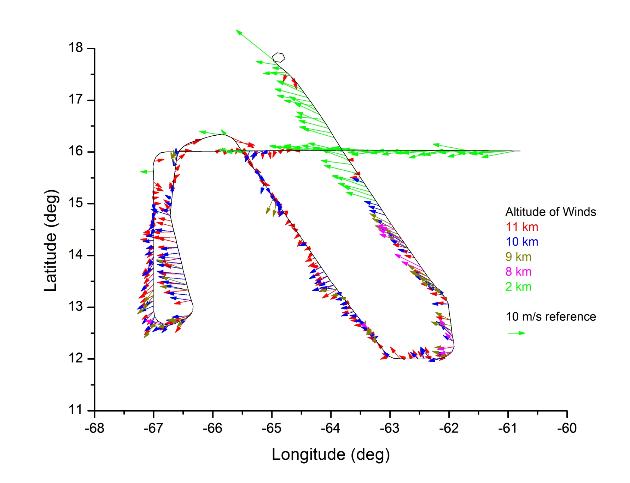
Example: Comparison of 5 Constant-Altitude Slices
9/21/10, data folder 192329, 60 shots averaged, ~202 minutes duration,
~ 285 horizontal wind profile attempts

Slide 13
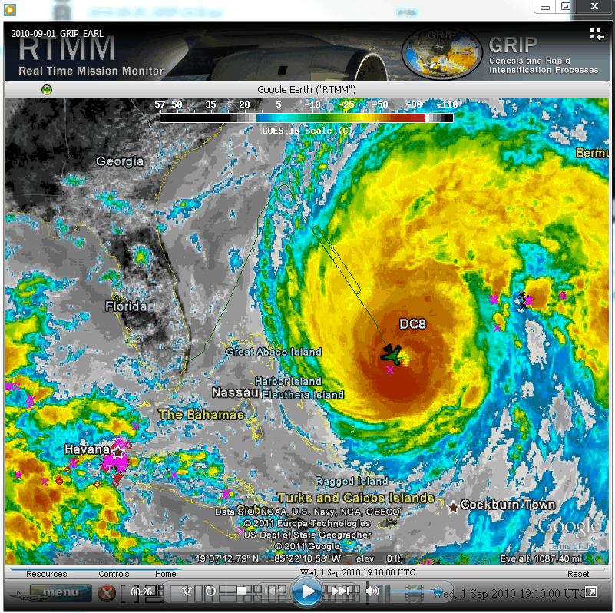
Example:
Crossing Hurricane Earl Eye
9/1/10
Eye crossing of Earl at ~19:12:00 Zulu

Slide 14
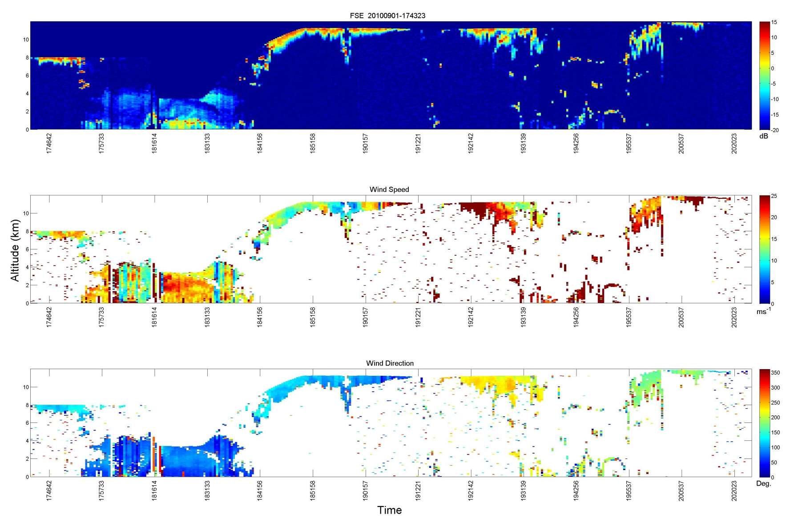
Example: Crossing Hurricane Earl Eye
9/1/10 Eye Crossing of Earl at ~19:12:00 Zulu
9/1/10, data folder 174323
Energy
25 m/s
Speed
Direction
What is dip at ~19:00:00?
~19:12:00 Zulu

Slide 15
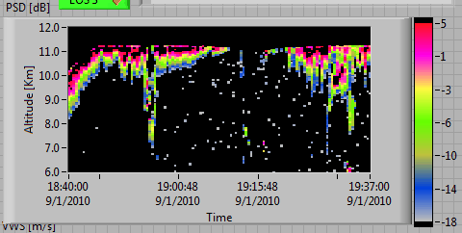
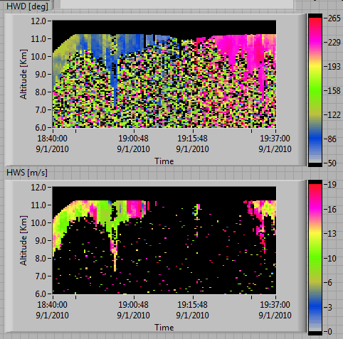
Energy
9/1/10 Eye Crossing
Zoom in Altitude, Zoom in Color Bars
Direction
~ 150 deg wind direction change across eye
Slower wind magnitude at dip
Higher wind magnitude down low in dip
Speed

Slide 16
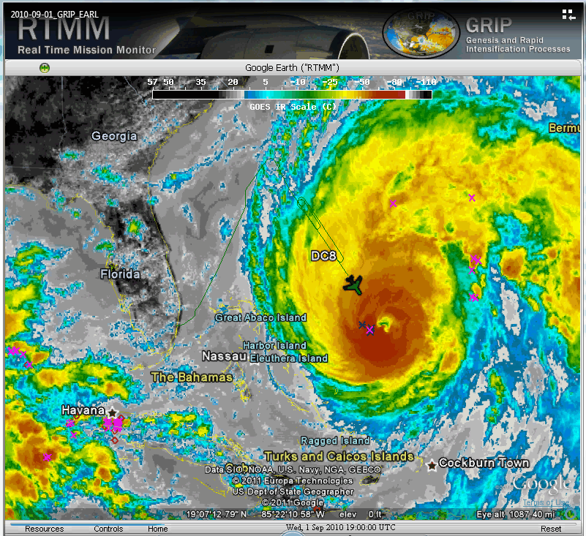
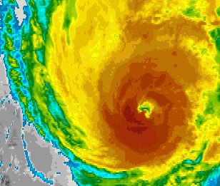
9/1/10 Eye Crossing
What is Dip at ~ 19:00:00?
NOAA: “In an infrared image, cold clouds are high clouds”
∴Warmer region is lower clouds, hence the dip

Slide 17
Summary
Our group’s first airborne science campaign
First flights of new instrument DAWN (pulsed, 2-micron, coherent Doppler lidar)
Hardware problems turned 250 mJ laser energy into effective 10 mJ
Problems mostly fixed now
Processing to date is single scan pattern, using only -45° and + 45° azimuth angles. Plan to use all 5 azimuth angles for better wind accuracy and coverage. Plan to average consecutive scan patterns for better coverage at expense of horizontal resolution.
Lots more information in data such as wind turbulence values and LOS wind profiles
Integrating DAWN into LaRC UC-12B aircraft to have two choices of aircraft
We sincerely hope the wind data will help GRIP investigators

Slide 18
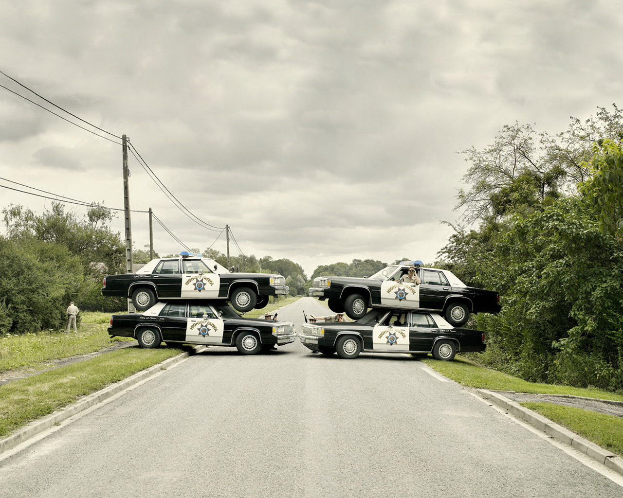
BACK UP

Slide 19
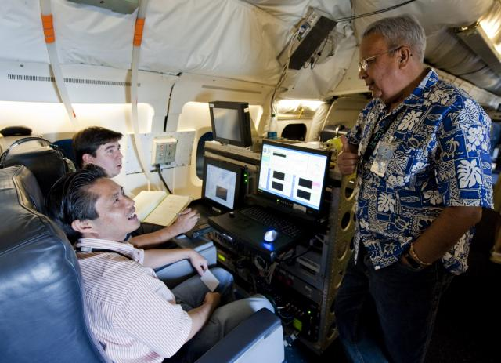
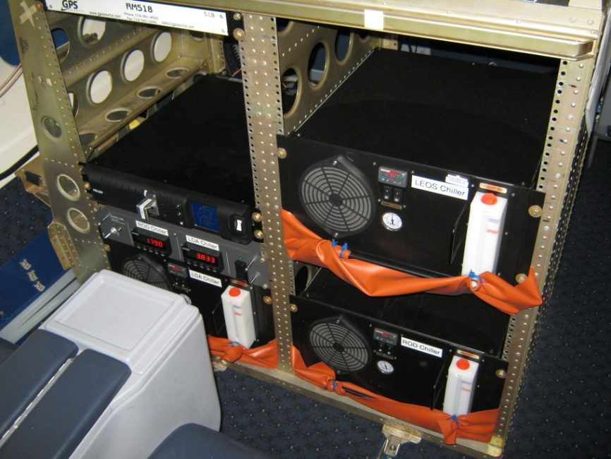
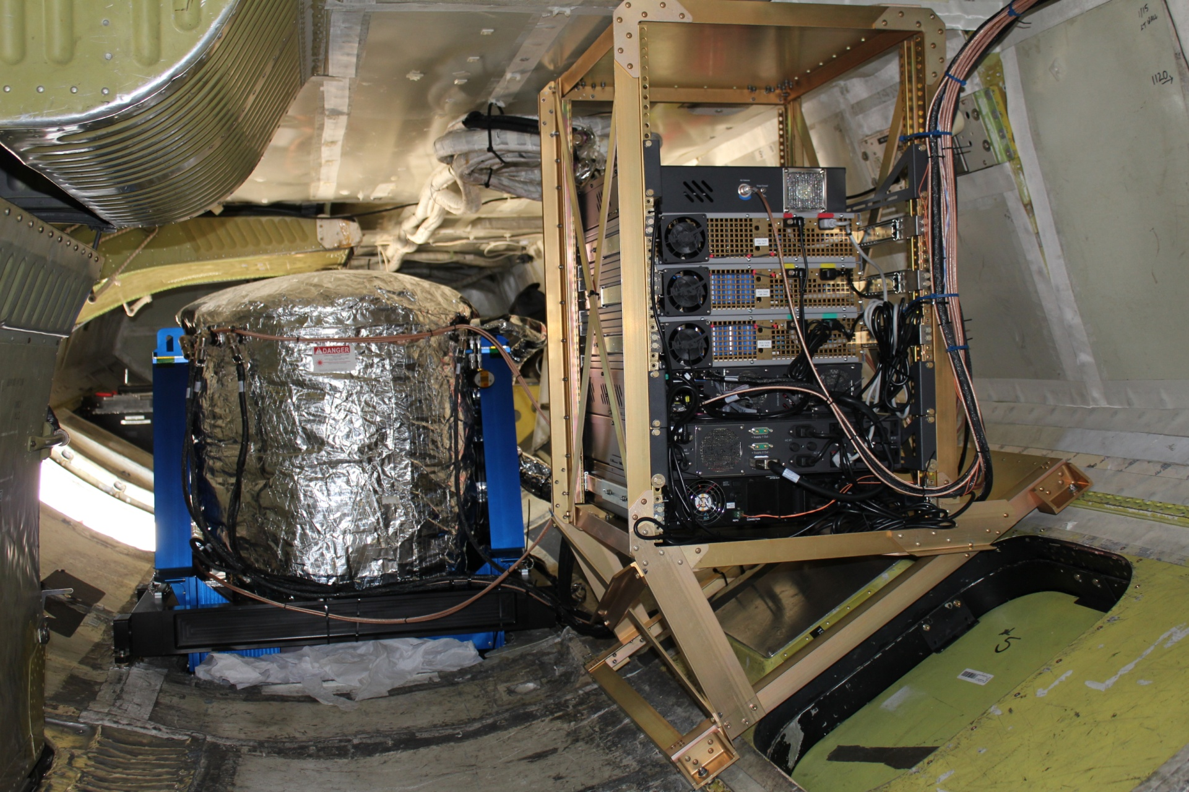
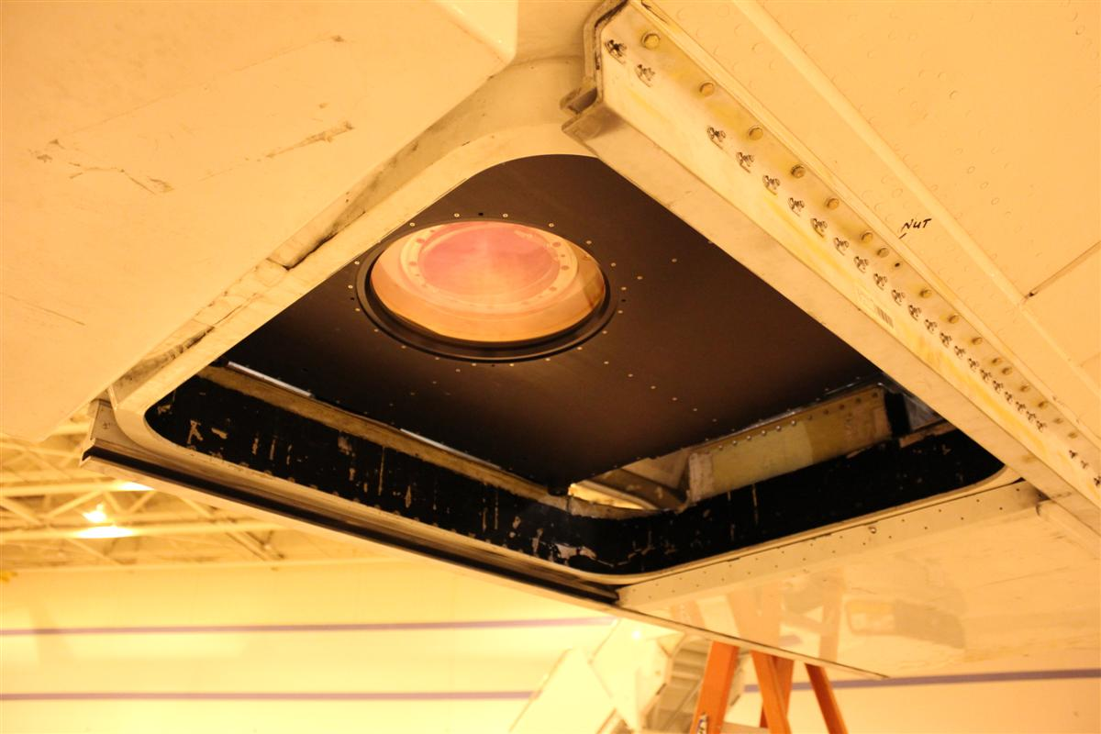
DAWN in DC-8 for GRIP
Three laser chillers
Laser control (L), and data acquisition control (R)
Optics canister above nadir window & electronics
Nadir window, shutter open

Slide 20
Pulsed, Coherent-Detection, 2-Micron, Doppler Aerosol Horizontal WiNd (DAWN) Profiling Lidar during GRIP
Pulsed Laser
Ho:Tm:LuLF, 2.05 microns
3.1 m folded ring resonator, FSR = 967 MHz
~250 mJ pulse energy
10 Hz pulse rate
200-220 ns pulse duration
Master Oscillator Power Amplifier
Laser Diode Array side pumped, 792 nm, 1 ms
~Transform limited pulse spectrum
~Diffraction limited pulse spatial quality
Designed and built at LaRC
Lidar System in DC-8
Optics can in cargo level
Centered nadir port 7
One electronics rack in cargo level
Two electronics racks in passenger level
Refractive optical wedge scanner, beam deflection 30.12° = nadir angle
Conical field of regard centered on nadir
All azimuth angles programmable
Data Acquisition & Processing
5 azimuth angles (-45°, -22.5°, 0°, 22.5°, 45°), all forward
500 Msamples/second ADC
Per sample 2 ns, 0.3 m, 0.26 m height
55,000 samples/shot, 512 samples pre-shot
Maximum 54,488 samples,109 microseconds, 16.335 km range
Nominal range gate 512 samples, 1 microsecond, 154 m, 133 m height
Range gate overlap 256 samples, 50%
N-shot, freq-aligned, averaged periodograms
Periodogram maximum 250 MHz
Periodogram maximum ±128 m/s LOS, ±256 m/s = ±572 mph horiz.
Periodogram information resolution 0.98 MHz, 1.0 m/s
Nominal range gate samples after zero padding 2048
Periodogram resolution for frequency alignment 0.24 MHz, 0.25 m/s
Lidar System
15-cm diameter off-axis telescope
Dual balanced heterodyne detection
InGaAs signal optical detectors (2)
InGaAs monitor optical detector (1)
Zero motion heterodyne frequency = 0 Hz
10-bit ADC
INS/GPS integrated to lidar
Pre Data Collection Selectable
Post Data Collection Selectable

Slide 21
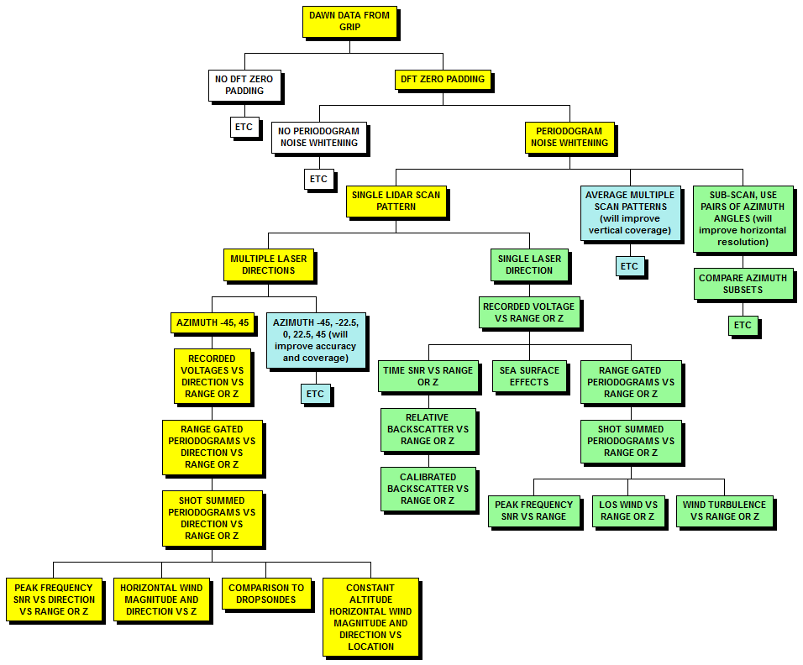
DAWN Data Processing Outline. All Data vs. Along-Track Dimension
Current
Effort
Second
Priority
Future
Work

Slide 22
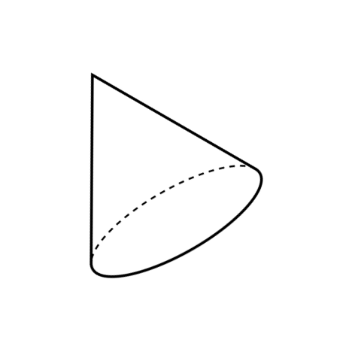
Nominal Scan Pattern: DAWN During GRIP Campaign
5 different azimuth angles from -45 to + 45°
2 sec shot integration; 2 sec scanner turn time
2 s, 288 m
144 m/s ground speed
-45°
-22.5°
0°
+22.5°
+45°
Trade Off
Fast revisit time to less azimuth angles
vs.
Slower revisit time to more azimuth angles (less cloud blockage?, wind variability studies, measure w)
Note: weather models assimilate LOS winds
30.12°
Example:
1 pattern = 22 s = 3,168 m
Along-Track & Temporal Resolution
Swath Width Depends on Flight
And Measurement Altitudes
e.g., Flight Altitude = 10,586.4 m
Measurement Altitude = 0 m
Swath Width = 8,688 m
-45°
-22.5°
0°
+22.5°
+45°
Nadir

Slide 23
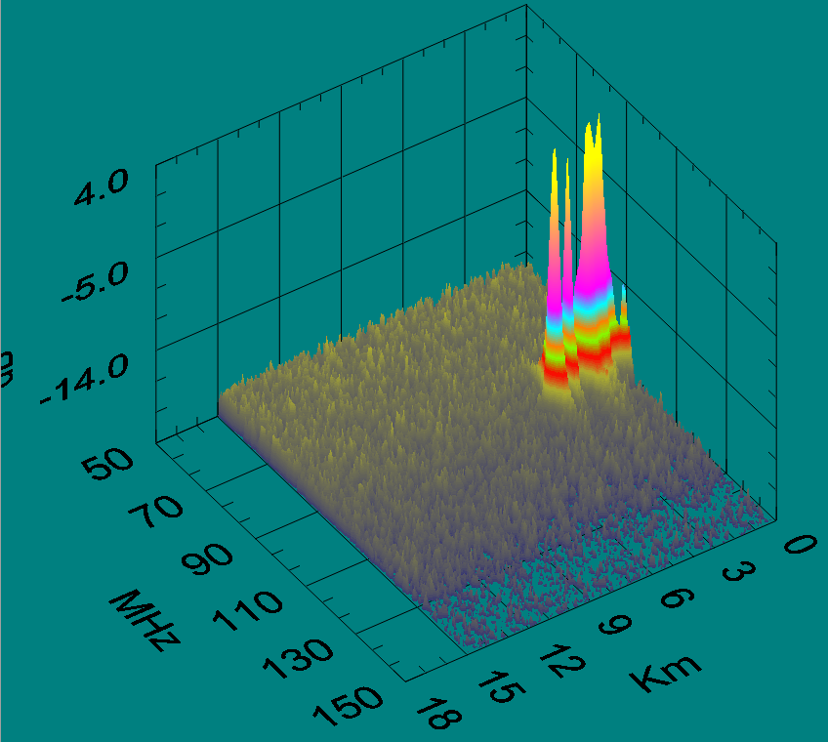
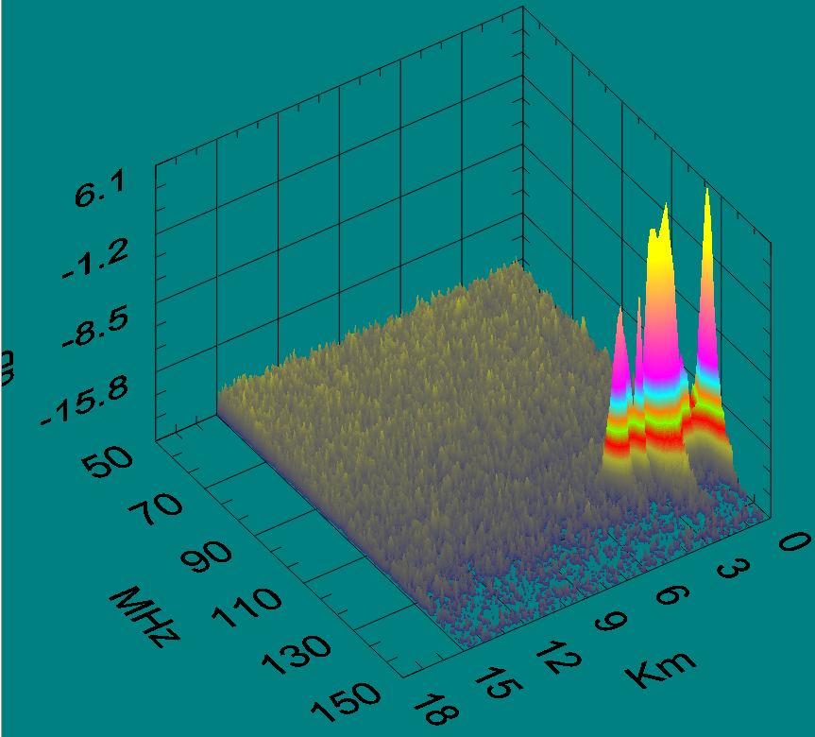
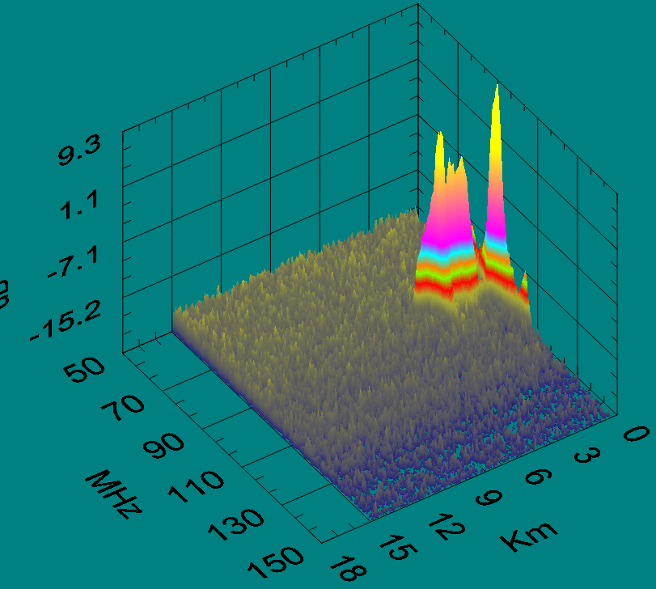
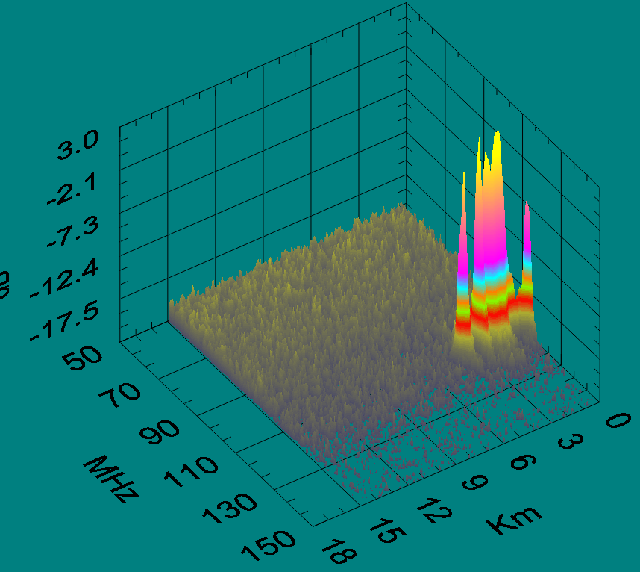
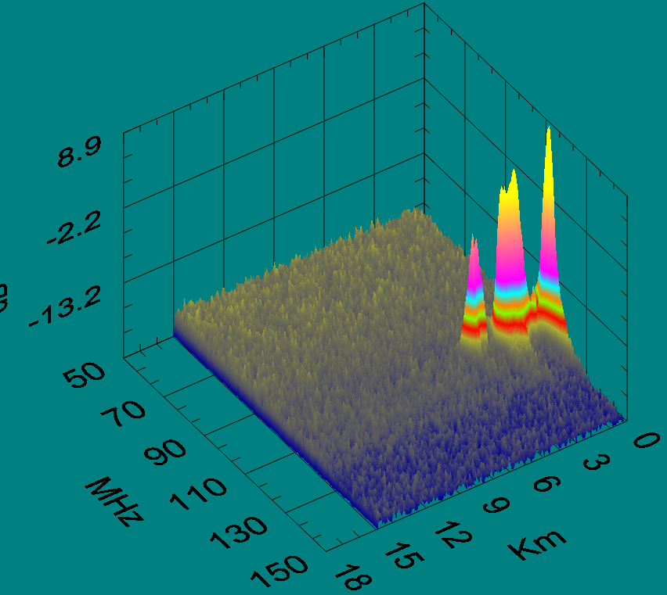
Example: Spectra vs. Azimuth Angle
8/24/10; data folder 143213; scan pattern 1, 60 laser shots averaged
Periodograms shifted to remove laser jitter before averaging
-45 Azimuth 1
0 Azimuth 3
45 Azimuth 5
dB
Slant range from DC-8
-22.5 Azimuth 2
22.5 Azimuth 4
In principle, zero, first, and second moments measured

Slide 24
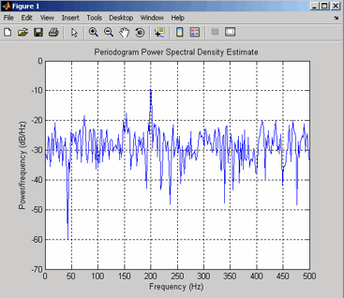
Periodogram: Estimating Signal Frequency After N_{P} Shot Accumulation One Range Gate, One Realization
Mean Data Level = L_{D}
Data Fluctuations = s_{D} = L_{D} /√N_{P}
Mean Signal Power = area under mean signal bump but above mean noise level. P_{S} = A_{S} = [(L_{D} – L_{N}) · Δf · 1] (if signal in one bin)
Q
Mean Noise Level = L_{N}
R
Noise Fluctuations = σ_{N}= L_{N} /√N_{P}
W
Mean Noise Power = area under mean noise level = R x W
J
Data = Signal + Noise, D = S + N
L

